Slide 1
EDUCATION AND EMPLOYMENT INITIATIVE (E2I) OPERATION WARFIGHTER (OWF)
Information Brief
Tristen Wendland
Senior Program Manager Operation Warfighter (OWF)
April 2025

Slide 2
Areas of Discussion
Warrior Care, Recovery Coordination Program
Education and Employment Initiative
Operation Warfighter
Contact Information and Social Media

Slide 3


Mission and Vision
OUR
MISSION
OUR
VISION
Proactively support Recovering Service Members (RSMs) in their recovery, rehabilitation, and reintegration back to the service or transition into civilian life.
Ensure the RSMs are well prepared for the next step in their lives through career development, support of caregivers and encouragement of lifelong adaptive activities for those with physical and emotional challenges.
Notes:
Randi

Slide 4
WC RCP Objectives
POLICY
Develops policy that standardizes non-medical care provided to wounded, ill, and injured Service members, families, and caregivers across Military Department and SOCOM RCPs throughout the continuum of care.
OVERSIGHT
Monitors and reports on the accessibility, utilization, and performance of DoD and Military Department and SOCOM RCPs.
OPERATIONS
Provides IT platform to track Comprehensive Recovery Plans for each RSM
Maintains the National Resource Directory, an online resource repository for service members, veterans, military families and caregivers
Executes the Employment and Education Initiative and Operation WARFIGHTER programs
COMMUNICATION
Performs strategic communication to ensure stakeholder awareness of policies, programs, and resources affecting wounded, ill, and injured Service members, families, and caregivers.

Slide 5
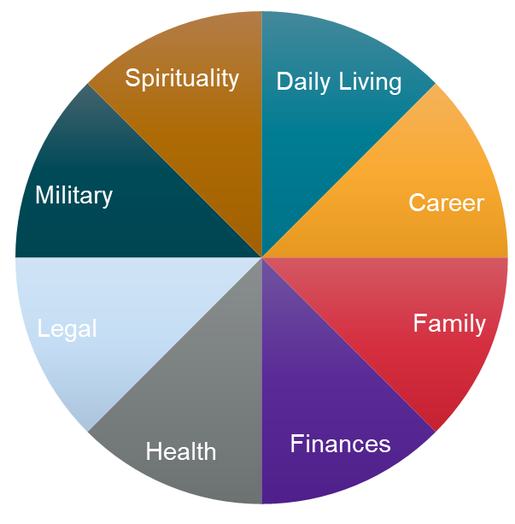
RSM Comprehensive Recovery Plan
Counseling
Retreats
Support groups
Adaptive needs
Housing
Transportation
Transition Assistance Program
Benefits and entitlements
Orders, Line of Duty
IDES
Education and Employment
Operation WARFIGHTER (OWF)
Employment and Education Initiative (E2I)
Veteran Readiness & Employment (VR&E)
Comprehensive Recovery Plan
Conservatorship
Guardianship
Court needs
Caregiver support
Respite care
Dependent care
VA Liaisons
Specialty care
Service dogs
Rehabilitation/ Adaptive sports
Military pay
VA disability claim
Financial counseling
Unemployment
SCAADL

Slide 6


Education and Employment Initiative (E2I)
OBJECTIVE
To assist Recovering Service members (RSMs) in identifying and matching their skills and experience with education and career opportunities.
Governed by: DoDI 1300.25 “Guidance for the Education and Employment Initiative (E2I) and Operation Warfighter (OWF)” – March 2013
Overview
Eligibility
Regional Coordinators (RC’s) work with the RSMs to determine education requirements for desired career path. These educational requirements may include formal degree programs or training, certification and licensing programs.
RC’s build relationships by developing partnerships with federal and private organizations across different industries. These partnerships are essential for identifying career matching opportunities for transitioning RSMs.
Service members going through the Disability Evaluation System
Service members in a warrior care program (Army Recovery Care Program, USMC Wounded Warrior Regiment, Navy Wounded Warrior, Air Force Wounded Warrior, SOCOM Warrior Care)
BENEFITS
Assists with developing a transition goal plan for education and/or employment
Aids RSMs with seeking new career opportunities beyond military
Works with Veterans Readiness and Employment (VR&E) counselors who assess and identify new skills of the RSMs
Reinforces skills by matching certifications and training for no cost; aids in use of available resources for furthering education and employment needs

Slide 7


Education & Employment Initiative (E2I)
Mission: To assist Recovering Service members (RSMs) in identifying and matching their skills and experience with education and career opportunities.
RSMs Assisted
Education and Outreach
Feedback
21%
Response Rate
900
Education and Outreach Events
97%
96%
89%
85%
10K
My education/ employment goals are addressed
Resources provided meet my needs
Would recommend E2I
E2I met my needs
Attendees
All data is for CY2024

Slide 8
Operation Warfighter (OWF)
OBJECTIVE
Regional Coordinators (RCs) connect Recovering Service members (RSMs) with Federal Agency internships during their rehabilitation process to transition military skills into civilian occupational success.
Governed by: DoDI 1300.25 “Guidance for the Education and Employment Initiative (E2I) and Operation Warfighter (OWF)” – March 2013
Overview
Eligibility
Department of Defense internship program for Recovering Service members
Internships are with federal agencies only
Internships cannot interfere with the Service member’s medical or rehabilitation requirements.
Service members going through the Disability Evaluation System
Service members in a warrior care program (Army Recovery Care Program, USMC Wounded Warrior Regiment, Navy Wounded Warrior, Air Force Wounded Warrior, SOCOM Warrior Care)
BENEFITS
Recovering Service member
Federal Agency Partner
Maximizes recovery time, provides valuable work experience in a non-military environment
Assists with developing new skills
Provides benefit of career preparedness upon transition to civilian life
Fresh perspectives and unique insights
Increased productivity for the organization
Cost-free solution

Slide 9


OWF Internship Process
APPLICATION
PLACED
INTERNSHIP
CLOSEOUT
Medical approval
Command approval
Interests and capabilities assessment
RC identifies opportunities with federal agencies
Interview(s)
Placed
Onboarding
Workplace accommodations
Development Plan
RC check-ins
Development Plan Reviewed
RSM Feedback
Federal Agency feedback
90 – 180 Days
Last 30 Days

Slide 10




OWF Forms
Partnership Form
Agreement between DoD and federal partner establishing parameters for both parties; expires after 5 years.
Intern Placement Form
Identifies the intern's information, responsibilities, duties, and schedule.
Intern Development Plan
Documents specific tasks associated with the internship as well as goals for the Service member.
Experience Feedback
Online questionnaire to obtain federal partner’s and service member’s experience feedback.

Slide 11








OWF Type of Talent
Administrative
Human Resources
Finance
Healthcare
Logistics
Management
Operations
Information Technology

Slide 12

Operation Warfighter (OWF)
Mission: Regional Coordinators (RCs) connect Recovering Service members (RSMs) with Federal Agency internships during their rehabilitation process to transition military skills into civilian occupational success.
21%
Internships
Top Federal Agency Hosts
RSM Feedback
Response Rate
DOD
DOE
USDA
DHS
DOJ
DOI
VA
95%
89%
91%
84%
Coordinator provided needed assistance
Met or exceed my expectations
Important part of my transition
Would recommend OWF
20
Federal Agency Hosts
Education and Outreach
Agency Feedback
756
Education and Outreach Events
RSM Attendance/Appearance
96%
RSM Performance
92%
9K
Attendees
RC Performance
95%
All data is for CY2024
OWF met expectations
88%
Notes:
Tristen

Slide 13
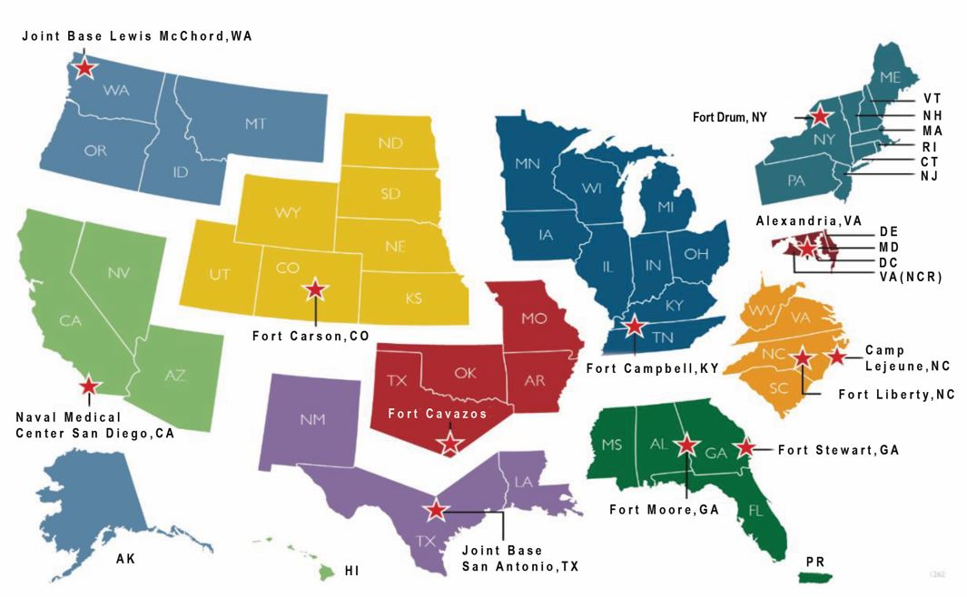
E2I/OWF Regional Coordinators
REGION 10 (Southwest)
REGION 9
REGION 1 (Northeast)
Christopher Graham, E2I
christopher.b.graham.ctr@mail.mil
619-964-6510
Sandra Ambotaite, OWF
sandra.ambotaite.ctr@mail.mil
951-904-1475
James West, E2I/OWF
james.w.west.ctr@mail.mil 680-291-0462
REGION 8
REGION 7
REGION 1
REGION 2 (NCR)
REGION 10
Martin Del Rio, E2I
martin.delrio.ctr@mail.mil
571-481-8648
Raymundo Esteves, OWF
raymundo.n.esteves.ctr@mail.mil 240-644-2715
REGION 9 (Northwest)
Ronald Metternich, E2I
ronald.j.metternich.ctr@mail.mil
253-330-0643
Ramon Ubaldo, OWF
ramon.e.ubaldo.ctr@mail.mil
253-324-5351
REGION 2
REGION 3 (Mid-Atlantic)
Antoinette Watson, E2I/OWF
Camp Lejeune antionette.d.watson2.ctr@mail.mil 252-624-1341
Marquadealsandro “Marq” McLeod, E2I/OWF
Fort Bragg
marquadealsandro.mcleod.ctr@mail.mil 803-260-1467
REGION 8 (Great Plains/Rocky Mt.)
Fort Bragg, NC
Naomi Dowsett, E2I
naomi.j.dowsett.ctr@mail.mil
719-460-1028
Daniel Stellabotte, OWF
daniel.stellabotte.ctr@mail.mil 719-491-1468
REGION 5
REGION 3
Fort Benning, GA
REGION 4
REGION 4 (Southeast)
REGION 7 (Midwest)
REGION 6
Lisa Goenen, E2I/OWF
Fort Stewart
lisa.g.goenen.ctr@mail.mil
912-200-0470
Ebony McMillian, E2I/OWF
Fort Benning
ebony.m.mcmillian2.ctr@mail.mil
706-773-1428
Ned Hall, OWF
ned.e.hall.ctr@health.mil
270-740-7505
James Gibson, E2I
james.w.gibson24.ctr@health.mil
931-800-8714
REGION 6 (South)
REGION 5 (South Central)
Lance Dowd, E2I
lance.a.dowd.ctr@mail.mil
703-397-6640
Erasmo Valles, OWF
erasmo.valles.ctr@mail.mil
703-397-6499
William May, E2I william.e.may3.ctr@mail.mil 682-216-5896
Eric Gehring, OWF
eric.b.gehring.ctr@mail.mil 254-226-4405
#
= Region Number
= Location of Regional Coordinators
Notes:
Randi

Slide 14
Recovery Coordination Program Leadership Contacts
Ms. Randi Ramcharan, Director, Warrior Care Recovery Coordination Program
Email: randi.r.ramcharan.civ@mail.mil
Mr. Jonathan Morris, Deputy Director, Warrior Care Recovery Coordination Program
Email: jonathan.a.morris12.civ@mail.mil
Mr. Jose Umpierre, Sr. Program Manager (Contractor)
Email: jose.j.umpierre.ctr@mail.mil

Slide 15






Social Media Platforms
https://www.warriorcare.dodlive.mil
https://www.nrd.gov
https://www.facebook.com/WarriorCare
https://www.facebook.com/NationalResourceDirectory
https://www.linkedin.com/company/department-of-defense-recovery-coordination-program-operation-warfighter
https://www.linkedin.com/company/national-resource-directory/
https://www.instagram.com/wariorcarephotos

Slide 16
Thank You
Phone Number: (719) 728-5538
Email: tristen.v.wendland.ctr@mail.mil

